Slide 1

Mizuho dashboard
SG Innovation Team

Slide 2
involved Parties
This is a collaboration between
PQM
AIOD
Tableau
Users
(SG Mizuho Stakeholders)

Slide 3
Objective
To bring Dashboard culture to Mizuho
Using tools such as Tableau, Qlik Sense, Microsoft BI (business intelligence) which are popular analytical dashboard tools
Business users and non-IT savvy staff can easily create the dashboards
Centralising Tableau is the top priority

Slide 4
Dashboard Tool - Tableau
What's Tableau
Grand master” of data visualization software
over 60,000 user accounts across a multitude of industries
interactive interface with simple drag-and-drop functionality speeds up and simplifies the creation process
can easily handle large, fast-changing datasets
integrates smoothly with various technologies e.g. Hadoop, AWS, MySQL, SAP and Teradata

Slide 5
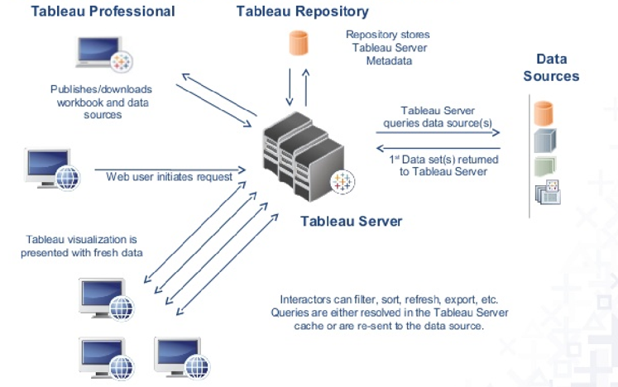
Goal
Deploy Tableau Server to enable collaboration and empower more users to gain insights from the dashboard while ensuring data governance
Centralized environment
Using Active Directory to access i.e. login using own Windows ID
Using web browser, no installation required

Slide 6
Dashboard Tool - Tableau
Tableau is not new to Mizuho
Currently we have 22 desktop licences (9 desktop, 13 creator) managed by different departments and having different expiry dates
AOOP/AOAD 7 (Desktop-6 Creator-1)
AOTD 3 (Desktop-3)
RMD 3 (Creator-3)
MRD 4 (Creator-4)
AIOD 5 (Creator-5)

Slide 7
Dashboard Tool - Tableau
Time Line
Bootcamp July Date from To
Training Aug
Testing Aug/Sep
UAT Sep
PROD Oct

Slide 8
Infra & Deployment
Tableau and Licences
Hardware
AIOD will prepare server by using existing hardware for
Development
Production. Servers are to be confirmed.
Software
- Convert desktop to server licence
- Align to same expiry date(Same annual cost when we renew desktop licences)
- Innovation Team to decide on how many new licences to purchase
Viewer licence
Other Documentation

Slide 9
Next Steps
Training
Tableau
Tableau Virtual Bootcamp – Time line
Tableau online eLearning – Time Line
Innovation Team
Workshops – Time Line
For users who need to create new workbooks, dashboards (Creators)
For users who need to view and interact with published workbooks, dashboards (Viewers)

Slide 10
End of Rotation Presentation
1 Oct 2019
Presented by Mizuho Singapore Graduate Program 3.0

Slide 11
Agenda
Transaction Banking Promotion (TBP) - Bing Hong
Commodity and Structured Trade Finance (CTF) - Thiru
Trade Product Execution (TPE) - Sheng Xun
Knowledge Management & Presence (KMP) – Zelia
Asia Oceania Corporate Banking 1 (CB1) – Gideon & Shawn
Asia Oceania Corporate Banking 2 (CB2) – Kin

Slide 12
Transaction Banking Promotion (TBP)
End of rotation presentation
Presented by Ho Bing Hong
MSGP 3.0

Slide 13
Outline
1
Overview of Rotation
Department Structure
Activities & Deliverables
2
Challenges & Opportunities
Database Marketing Initiative
Corporate Treasury Advisory
3
Key Takeaways

Slide 14
Transaction Banking Promotion Department Structure
Transaction Banking Promotion
Branch Support & Implementation
Corporate Treasury Advisory
Strategic Marketing
Support branch to develop TB infrastructure
Enhance Database Marketing to promote regional TB activities
Support implementation of solutions to customers at the branch level
Support marketing by consultation approach with regulatory/ accounting/ risk management expertise
Support inbound/outbound business for branches
Support TB without dedicated GTBD desk

Slide 15
Activities & Deliverables
Overview of the past 14 weeks
June
July
August
September
Trainings & Exposures
Transaction Banking (“TB”) Foundation Training
Understand Mizuho Cash & Trade Products/Capabilities
Understand the Database Marketing (“DBM”) Initiative
Role of the Implementation Manager in TB
Basic functions of MGeB
TB Sales to Client Servicing Process
Limitations of TRICS/SAIL/SAFE databases
Database (TRICS/SAIL/SAFE) Utilisation Training for RMs
Database Marketing
TB Profitability Report (Philippines)
BMI TB Profitability Report
DBM Presentation Deck for Asia-Oceania (“AO”) Region GM Conference
TB Profitability Report India (Bangalore, Chennai, Mumbai, New Delhi)
Macros to automate the combination of segmented data
Mizuho-Mizuho transactions report (remittances)
Customer’s Remittance Data and the utility of Mizuho’s TB Services (Vietnam, Philippines, Singapore, Malaysia)
Singapore Non-Japanese (“NJP”) customers’ TB Profitability Report
Analytical Report of Customer’s historical Dividend Remittances (Singapore) for FY2015-2018
SWIFT Watch Data extraction for MT103, MT202c and MT700 FIN messages
SWIFT Watch data mapping with existing TRICS data and identified business opportunities for GTBD
Corporate Treasury Advisory
Industry Analysis for U.S. Textiles & Apparel Market
Detailed Analysis of Shared Service Environment (“SSE”) of the AO Region

Slide 16
Database Marketing (“DBM”) Initiative – Overview
Background / Objectives
Challenges
Approach
“Transaction & Corporate Banking Model”
Enhance TB know-how of RMs – supported through training programmes conducted by GTBD
Provide clear targets to RMs to identify business opportunities – supported through database marketing activities
Improve profitability of the bank
Limited use of self-help database tools by RMs in the Asia-Oceania (“AO”) Region
Multiple sources of data are available within the bank (e.g. TRICS, SWIFT Watch, REMIX – Hyperion / IGCIS)
Databases exist in silo and primary key identifiers (e.g. names and GCIF/CCIF) are inconsistent
Develop and use Excel VBA macros to automate the consolidation and sorting of data sets into a more intuitive presentation format
Gather and consolidate information from multiple data sources into intuitive reports for RMs
Engage with PQM and external IT vendor to develop an ontology-based data aggregation and analysis solution
Engage RMs through database training sessions

Slide 17
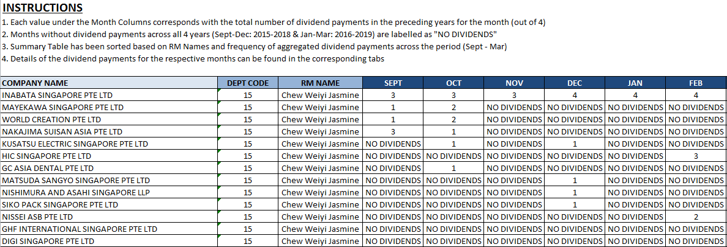
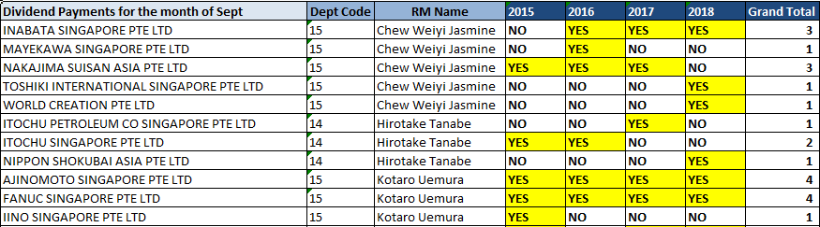
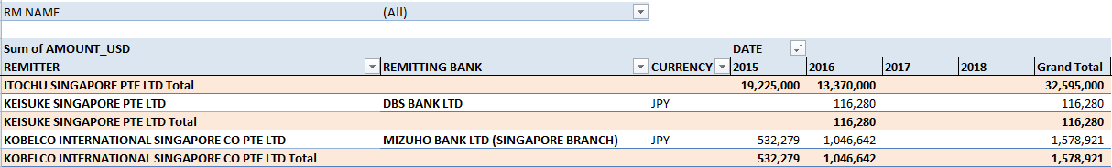
DBM Initiative – Branch Requests
Dividend Remittances
Objective: To identify potential customers to create FX and Deposit Profit Opportunities
Deliverable: Developed a model to easily identify customers with specific dividend payment patterns using simple keyword searches such as ‘Div’ and ‘Devid’
Outcome: RMs can better identify target customers based on their respective dividend payment cycle and reach out to them in a timely manner

Slide 18
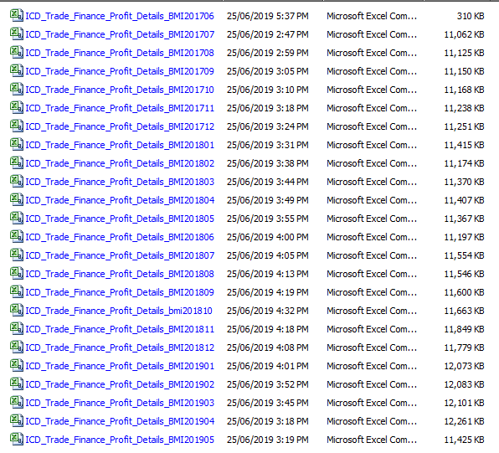
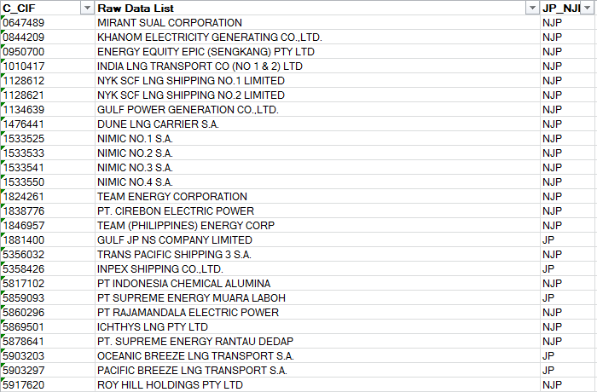
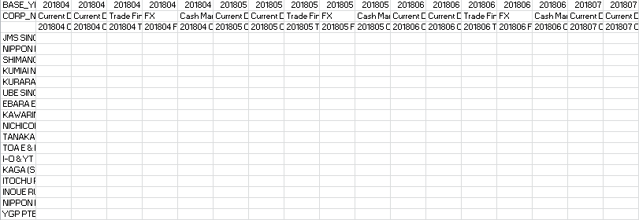
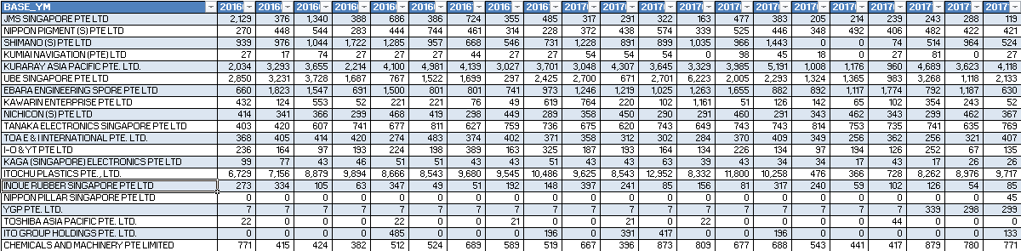
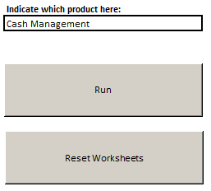
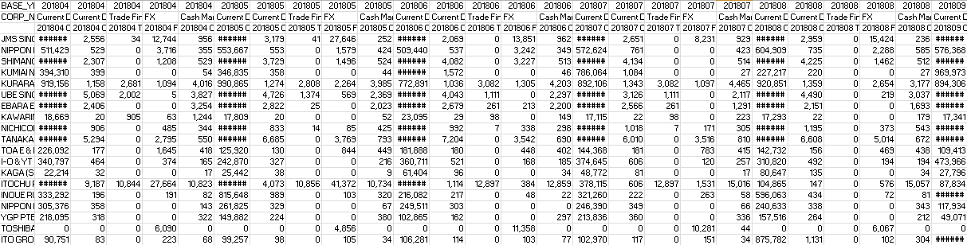
DBM Initiative – Consolidation of Product-Specific TB Profit Data
1. Extract Customer Profit Files from Hyperion
2. Consolidate Customer List
Limited Capacity on Hyperion for file extraction
Consolidated Customer List with duplicates removed
3. Automated Aggregation of Profit Data
4. Automated Segregation of Product Profits
Formulated cells to auto-populate values from raw data
Macro to automate creation of product-specific TB profit worksheets for the FY

Slide 19
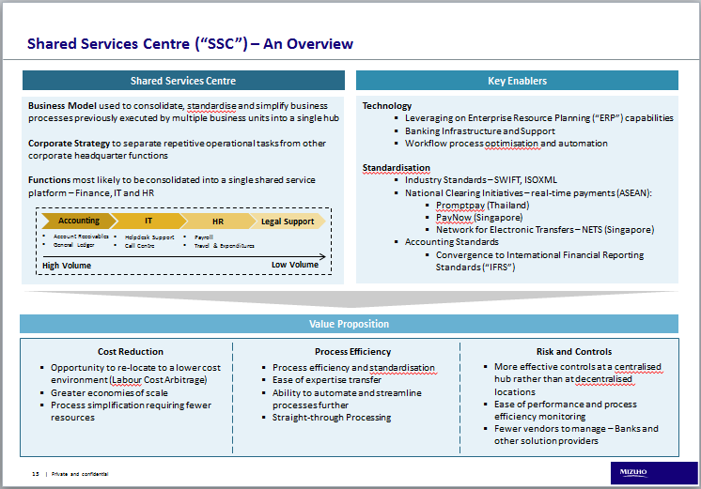
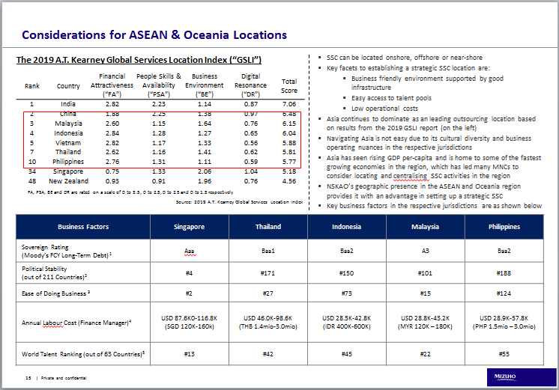
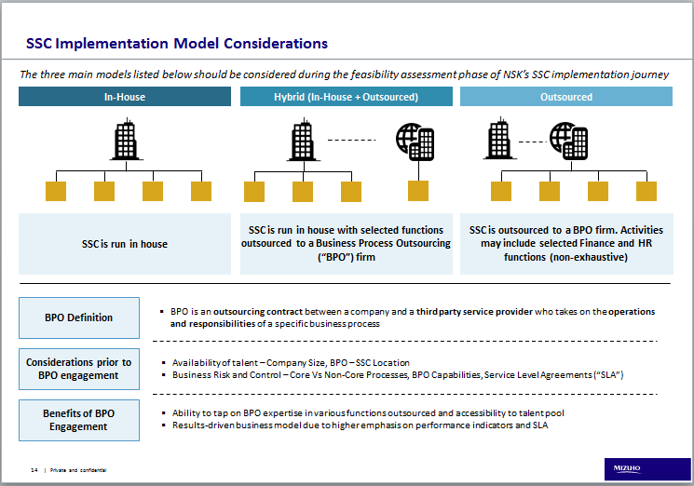
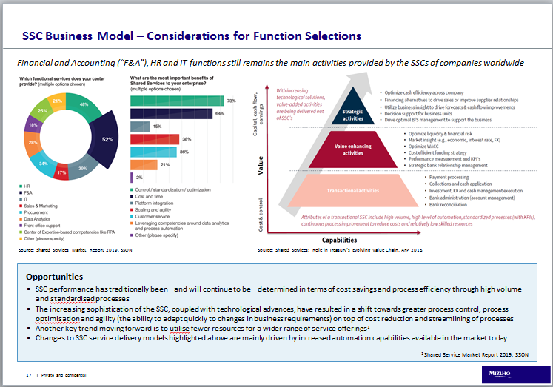
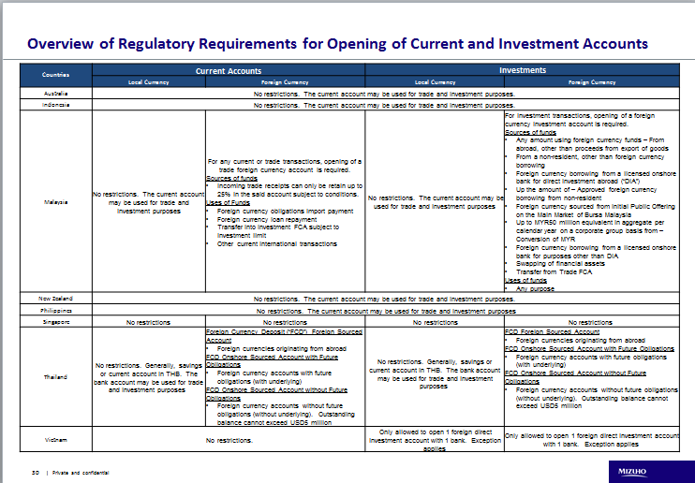
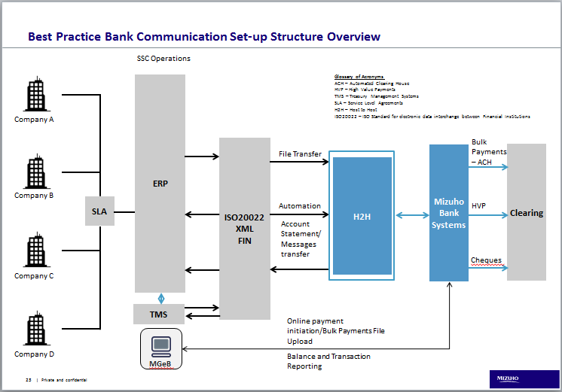
Corporate Treasury Advisory – Client N
Project: Considerations and banking solutions for a Shared Service Environment
Objective:
Description of the Shared Services Centres (“SSC”) concept
Banking solutions available with the SSC
Bank Account Rationalisation – Streamline banking needs across AO region to 1-2 major banks

Slide 20



Key Takeaways
Juggling Multiple Workloads
Stakeholder Management
Steep Learning Curve
Prioritise deliverables
To-do List
Request for help
Understanding differing perspectives
Understanding the needs and objectives of target audience
Clarify doubts
Self-study

Slide 21
End of Rotation Presentation Global Transaction Banking Department Commodity and Structured Trade Finance
MB
Internal
Oct 1, 2019
Presented by Thiru Naidu
Mizuho Singapore Graduate Program 3.0

